Slide 1
Morphology Instruction
cred
Notes:
Have students open their flash drives.
These slides would be taught over a number of days. They will probably take multiple weeks for students to complete since this is their first exposure to these concepts.

Slide 2
What is a root?
autobiography
project
deduct
benefactor
Notes:
Review options: give students 1 minute and have them write down as many words with graph as they can, or ask someone to lead you through LINCS with graph (on next slide), and then go around the room asking each person to give one word that contains this root.

Slide 3
Review with LINCS
What is the story?
What is the reminding word?
What is the word?
What is the definition?

Slide 4
cred
I believe that I can pay off all my credit cards.
To believe
credit card

Slide 5
Notes:
A preview of all the words students will have a better understanding of if they learn “ject”

Slide 6
If you pay all your bills on time, you will have a good credit score!
Do you recognize the root? (whiteboard)
Try out the meaning of the root in the sentence.
What do you think the word means?
Notes:
Have ½ the class do sentence number 1 and ½ the class do sentence number 2.

Slide 7
Add it to your personal dictionary
word | prefix | suffix | root | definition | sample
To believe in
or put trust in
credit
cred
Notes:
Students make an inference about the definition. Teacher/aide monitor and correct as needed. Have the students come up with the answers before answers appear. Have a brief conversation about how literal meaning “to lead away” doesn’t capture the essence (connotation) of the word.

Slide 8
1. Monique tries to discredit what Gerald and Angel are saying about Jordan in court.
Do you recognize the root? (whiteboard)
Try out the meaning of the root in the sentence.
What do you think the word means?

Slide 9
Add it to your personal dictionary
word | prefix | suffix | root | definition | sample
To not believe in or
trust
discredit
dis
cred
Notes:
Students make an inference about the definition. Teacher/aide monitor and correct as needed. Have the students come up with the answers before answers appear.

Slide 10
Credit or discredit?
The bank gave me a loan!
The detective found out I wasn’t were I said I was at the time of the crime.
My teacher gave me points even though she couldn’t find my work.
My friend found evidence that I cheated during the basketball game.
My girlfriend told everyone I was a player!

Slide 11
1. You missed the bus, and that’s why you were late to school? That’s credible.
Do you recognize the root? (whiteboard)
Try out the meaning of the root in the sentence.
What do you think the word means?

Slide 12
Add it to your personal dictionary
word | prefix | suffix | root | definition | sample
Able to
believe
credible
ible
cred
Notes:
Students make an inference about the definition. Teacher/aide monitor and correct as needed. Have the students come up with the answers before answers appear.

Slide 13
You were attacked by transformers and that’s why your late to school? That’s incredible!
Do you recognize the root? (whiteboard)
Try out the meaning of the root in the sentence.
What do you think the word means?

Slide 14
Add it to your personal dictionary
word | prefix | suffix | root | definition | sample
Not able
to believe
incredible
in
ible
cred
Notes:
Students make an inference about the definition. Teacher/aide monitor and correct as needed. Have the students come up with the answers before answers appear. Note: You want them to try and create a fairly literal definition with root word and prefix.

Slide 15
credible or incredible? Move to one side of the room before the applause is done!
The dog ate my homework.
I lost my homework.
I ate my homework.
I forgot my homework.
I play GTA5 all day and all night.
I only eat broccoli.
I won the lottery.
I sleep standing up.
My fingernails are ticklish.
My other job is being a hand model.
Notes:
Hang up signs on opposite sides of room “credible” and “incredible” after each statement comes up ask students to move under the sign the feel is most accurate.

Slide 16
I put credence into what my teacher says.
I put credence into what my parent says.
Do you recognize the root? (whiteboard)
Try out the meaning of the root in the sentence.
What do you think the word means?

Slide 17
Add it to your personal dictionary
word | prefix | suffix | root | definition | sample
Belief in
someone or something as true or right
credence
ence
cred
Notes:
Students make an inference about the definition. Teacher/aide monitor and correct as needed. Have the students come up with the answers before answers appear. Note: You want them to try and create a fairly literal definition with root word and prefix. Before they come up with a definition point out root word fact as factory and see if they can infer it means make.

Slide 18
I could tell she didn’t believe me, by her incredulous look.
Do you recognize the root? (whiteboard)
Try out the meaning of the root in the sentence.
What do you think the word means?

Slide 19
Add it to your personal dictionary
word | prefix | suffix | root | definition | sample
Showing that you don’t believe
incredulous
in
ous
cred
Notes:
Students make an inference about the definition. Teacher/aide monitor and correct as needed. Have the students come up with the answers before answers appear. Note: You want them to try and create a fairly literal definition with root word and prefix.

Slide 20
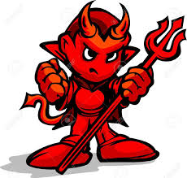
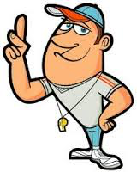
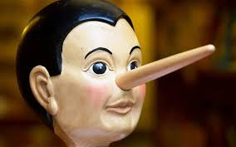
I would/wouldn’t put credence into what this person says because_____.

Slide 21
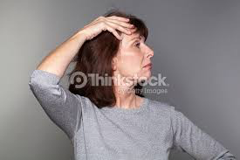
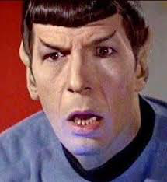
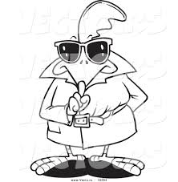
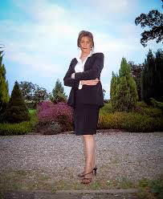
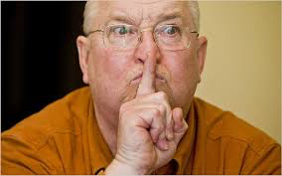
incredulous, superior, or secretive?
He/She is ___________because______________.

Slide 22
A teacher has to have the right credentials before she can teach.
Before we hire you as a life guard show us your credentials.
Do you recognize the root? (whiteboard)
Try out the meaning of the root in the sentence.
What do you think the word means?

Slide 23
Add it to your personal dictionary
word | prefix | suffix | root | definition | sample
Proof that
we can
believe something or
someone is qualified
to do something
credentials
tial
cred
s
Notes:
Students make an inference about the definition. Teacher/aide monitor and correct as needed. Have the students come up with the answers before answers appear. Note: You want them to try and create a fairly literal definition with root word and prefix.

Slide 24
If your high school is not accredited your diploma does not count!
Do you recognize the root? (whiteboard)
Try out the meaning of the root in the sentence.
What do you think the word means?

Slide 25
Add it to your personal dictionary
word | prefix | suffix | root | definition | sample
Belief that
something
has authority
accredited
ed
cred
Notes:
Students make an inference about the definition. Teacher/aide monitor and correct as needed. Have the students come up with the answers before answers appear. Note: You want them to try and create a fairly literal definition with root word and prefix.

