Slide 1
Morphology Instruction
graph
Notes:
Have students open their flash drives.
These slides would be taught over a number of days. They will probably take multiple weeks for students to complete since this is their first exposure to these concepts.

Slide 2
What is a root?
prediction
dictator
Notes:
Prediction: to speak before (dict means speak)
Dictator: a person who speaks INTRO. JUST TO GET THE IDEA. COULD USE ANOTHER WORD IF STUDENTS ARE MORE FAMILIAR

Slide 3
graph
I sit in the grass and write.
.
write
grass

Slide 4
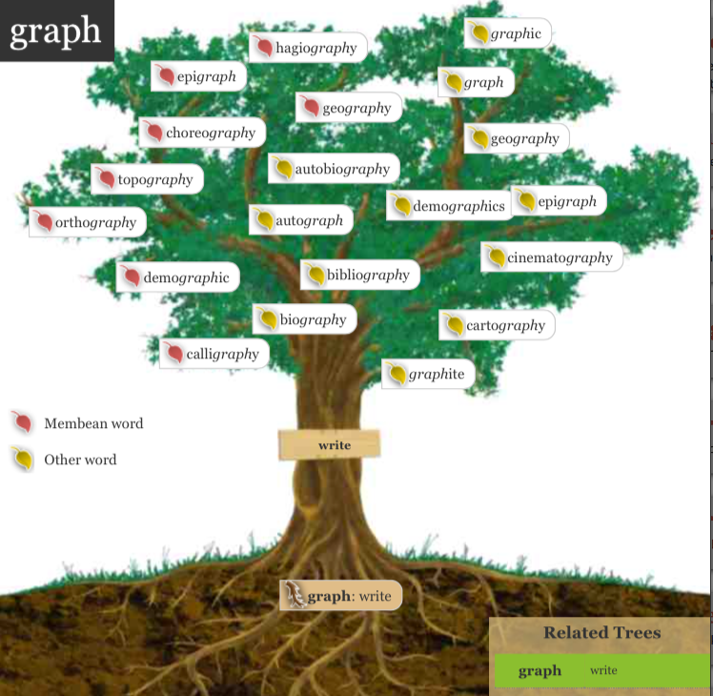

Slide 5
After she looked at the painting, she began to read the painter’s biography.
Do you recognize the root? (whiteboard)
Try out the meaning of the root in the sentence.
What do you think the word means?

Slide 6
Add it to your personal dictionary
word | prefix | suffix | root | definition | sample
y
Writing about
life
biography
bio
graph
Notes:
Students make an inference about the definition. Teacher/aide monitor and correct as needed.

Slide 7
In her autobiography she is not honest about her illness or how it came about.
Do you recognize the root? (whiteboard)
Try out the meaning of the root in the sentence.
What do you think the word means?

Slide 8
Add it to your personal dictionary
word | prefix | suffix | root | definition | sample
y
Writing about life
by his or herself
biography
bio
auto
graph
Notes:
Students make an inference about the definition. Teacher/aide monitor and correct as needed.

Slide 9
I took a street that should, by all the laws of geography , have taken me to La Brea.
Do you recognize the root? (whiteboard)
Try out the meaning of the root in the sentence.
What do you think the word means?

Slide 10
Add it to your personal dictionary
word | prefix | suffix | root | definition | sample
y
Writing about the
earth
geography
geo
graph
Notes:
Students make an inference about the definition. Teacher/aide monitor and correct as needed.

Slide 11
They all sat waiting for John to bring the drinks, but a woman at the bar stopped him to ask for his autograph.
Do you recognize the root? (whiteboard)
Try out the meaning of the root in the sentence.
What do you think the word means?

Slide 12
Add it to your personal dictionary
word | prefix | suffix | root | definition | sample
self
writing
autograph
auto
graph
Notes:
Students make an inference about the definition. Teacher/aide monitor and correct as needed.

Slide 13
The graph showed them exactly how many people lived in Los Angeles last year.
Do you recognize the root? (whiteboard)
Try out the meaning of the root in the sentence.
What do you think the word means?

Slide 14
Add it to your personal dictionary
word | prefix | suffix | root | definition | sample
Writing that shows information
graph
graph
Notes:
Students make an inference about the definition. Teacher/aide monitor and correct as needed.

Slide 15
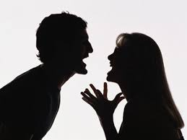
Neil and Susan, two designers, were arguing over which colors to use on a graphic.
Do you recognize the root? (whiteboard)
Try out the meaning of the root in the sentence.
What do you think the word means?

Slide 16
Add it to your personal dictionary
word | prefix | suffix | root | definition | sample
a visual writing or
drawing
graph
ic
graph
Notes:
Students make an inference about the definition. Teacher/aide monitor and correct as needed.

