Slide 1
Morphology Instruction
Review and Practice
Notes:
Have students open their flash drives.
These slides would be taught over a number of days. They will probably take multiple weeks for students to complete since this is their first exposure to these concepts.

Slide 2
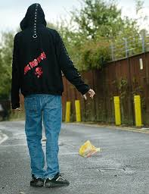
ject
The jerk throws trash on the ground.
To throw
jerk
Notes:
Try going in a different order to reinforce LINCS. Remember it is a memory tool, so we want students to remember the picture, story, and/or reminding word in order to remember the definition.

Slide 3
Challenge:
You must stay facing forward (no looking at word wall)
You have 1 minute.
Your choice- record with your phone or iPad and say as many words with ject as you can OR write as many as you can on your whiteboard.

Slide 4
He watched some sort of long projectile fly up into the air, turn, and come crashing back down.
Do you recognize the root? (whiteboard)
Try out the meaning of the root in the sentence.
What do you think the word means?
Notes:
Have ½ the class do sentence number 1 and ½ the class do sentence number 2.

Slide 5
Add it to your personal dictionary
word | prefix | suffix | root | definition | sample
An object that
is thrown forth
projectile
pro
ile
ject
Notes:
Students make an inference about the definition. Teacher/aide monitor and correct as needed. Have the students come up with the answers before answers appear. Have a brief conversation about how literal meaning “to lead away” doesn’t capture the essence (connotation) of the word.

Slide 6
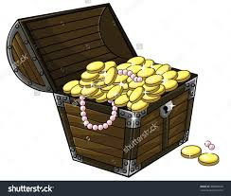
cred
I believe there is gold in that crate.
To believe
crate

Slide 7
Challenge:
You must stay facing forward (no looking at word wall)
You have 1 minute.
Your choice- record with your phone or iPad and say as many words with cred as you can OR write as many as you can on your whiteboard.

Slide 8
Harry’s personal credo is "YOLO.”
Do you recognize the root? (whiteboard)
Try out the meaning of the root in the sentence.
What do you think the word means?

Slide 9
Add it to your personal dictionary
word | prefix | suffix | root | definition | sample
Statement of beliefs; beliefs to live by
credo
cred
Notes:
Students make an inference about the definition. Teacher/aide monitor and correct as needed. Have the students come up with the answers before answers appear.

Slide 10
Challenge
What is your credo about life?
My credo about life is _____________
because__________________________.

Slide 11
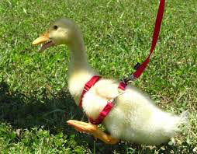
Vocabulary
duct
I lead the duck around like it is my pet.
To lead
duck

Slide 12
Challenge:
You must stay facing forward (no looking at word wall)
You have 1 minute.
Your choice- record with your phone or iPad and say as many words with duc/duct as you can OR write as many as you can on your whiteboard.

Slide 13
1. A psychologist was found guilty of serious professional misconduct yesterday.
Do you recognize the root? (whiteboard)
Try out the meaning of the root in the sentence.
What do you think the word means?

Slide 14
Add it to your personal dictionary
word | prefix | suffix | root | definition | sample
Leading oneself in a
wrong, or bad, way
misconduct
mis
duct
Notes:
Students make an inference about the definition. Teacher/aide monitor and correct as needed. Have the students come up with the answers before answers appear.

Slide 15
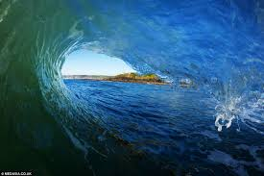
serv
He was waiting on the waves to surf.
To wait on,
or serve
surf
Notes:
Definition: wait on, serve

Slide 16
Challenge:
You must stay facing forward (no looking at word wall)
You have 1 minute.
Your choice- record with your phone or iPad and say as many words with serv as you can OR write as many as you can on your whiteboard.

Slide 17
1. Like any other public servants, police must respond to public demand.
Do you recognize the root? (whiteboard)
Try out the meaning of the root in the sentence.
What do you think the word means?

Slide 18
Add it to your personal dictionary
word | prefix | suffix | root | definition | sample
One who waits on or serves the people
Public
servant
ant
serv
Notes:
Students make an inference about the definition. Teacher/aide monitor and correct as needed. Have the students come up with the answers before answers appear. Prefix sub changes to sup when root starts with p- other example: suppress

Slide 19
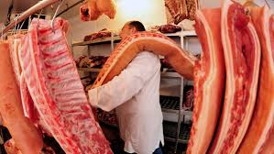
port
I carried the pork on my shoulder.
To carry
pork

Slide 20
Challenge:
You must stay facing forward (no looking at word wall)
You have 1 minute.
Your choice- record with your phone or iPad and say as many words with port as you can OR write as many as you can on your whiteboard.

Slide 21
1. After dinner that evening, Edith showed them a portfolio of her own political cartoons.
Do you recognize the root? (whiteboard)
Try out the meaning of the root in the sentence.
What do you think the word means?

Slide 22
Add it to your personal dictionary
word | prefix | suffix | root | definition | sample
port
A case to carry papers
portfolio
Notes:
Students make an inference about the definition. Teacher/aide monitor and correct as needed. Have the students come up with the answers before answers appear. Prefix sub changes to sup when root starts with p- other example: suppress

Slide 23
dict
A dictionary has words in it that I say.
To say or speak
dictionary

Slide 24
Challenge:
You must stay facing forward (no looking at word wall)
You have 1 minute.
Your choice- record with your phone or iPad and say as many words with dict as you can OR write as many as you can on your whiteboard.

Slide 25
1. A survey of retired people has indicated that most are independent and enjoying life.
Do you recognize the root? (whiteboard)
Try out the meaning of the root in the sentence.
What do you think the word means?

Slide 26
Add it to your personal dictionary
word | prefix | suffix | root | definition | sample
Speaks to something; shows or points out
indicate
in
ate
dic
Notes:
Students make an inference about the definition. Teacher/aide monitor and correct as needed. Have the students come up with the answers before answers appear. Prefix sub changes to sup when root starts with p- other example: suppress

Slide 27
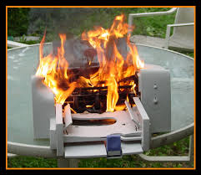
prim
I didn’t now how
to use my first printer, so I set it on fire.
first
printer

Slide 28
Challenge:
You must stay facing forward (no looking at word wall)
You have 1 minute.
Your choice- record with your phone or iPad and say as many words with prim as you can OR write as many as you can on your whiteboard.

Slide 29
1. You need to apply primer before you can paint the wall a new color. .
Do you recognize the root? (whiteboard)
Try out the meaning of the root in the sentence.
What do you think the word means?

Slide 30
Add it to your personal dictionary
word | prefix | suffix | root | definition | sample
First coat
primer
er
prim
Notes:
Students make an inference about the definition. Teacher/aide monitor and correct as needed. Have the students come up with the answers before answers appear. Prefix sub changes to sup when root starts with p- other example: suppress

Slide 31
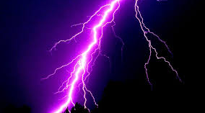
Lightning Round Example: primal- “prim- first”
abdicate
benefactress
malediction
ductile
underserved
primordial
conjecture

