Slide 1
Morphology Instruction
bene/ben
Notes:
Have students open their flash drives.
These slides would be taught over a number of days. They will probably take multiple weeks for students to complete since this is their first exposure to these concepts.

Slide 2
What is a root?
autobiography
project
deduct
Notes:
Review options: give students 1 minute and have them write down as many words with graph as they can, or ask someone to lead you through LINCS with graph (on next slide), and then go around the room asking each person to give one word that contains this root.

Slide 3
Review with LINCS
What is the story?
What is the reminding word?
What is the word?
What is the definition?

Slide 4
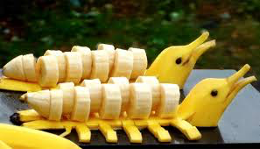
bene
Bananas
are good for you.
good
banana

Slide 5
Notes:
A preview of all the words students will have a better understanding of if they learn “ject”

Slide 6
The new computers at the school will benefit the students.
Do you recognize the root? (whiteboard)
Try out the meaning of the root in the sentence.
What do you think the word means?
Notes:
Have ½ the class do sentence number 1 and ½ the class do sentence number 2.

Slide 7
Add it to your personal dictionary
word | prefix | suffix | root | definition | sample
To be good
for something or
someone
benefit
bene
Notes:
Students make an inference about the definition. Teacher/aide monitor and correct as needed. Have the students come up with the answers before answers appear. Have a brief conversation about how literal meaning “to lead away” doesn’t capture the essence (connotation) of the word.

Slide 8
_________ (is/is not)a benefit. because__________.

Slide 9
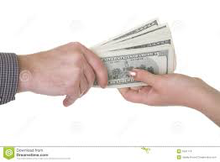
_________ (is/is not)a benefit. because__________.

Slide 10
_________ (is/is not)a benefit. because__________.

Slide 11
_________ (is/is not)a benefit. because__________.

Slide 12
_________ (is/is not)a benefit. because__________.

Slide 13
_________ (is/is not)a benefit. because__________.

Slide 14
1. Recycling is highly beneficial for the environment.
Do you recognize the root? (whiteboard)
Try out the meaning of the root in the sentence.
What do you think the word means?

Slide 15
Add it to your personal dictionary
word | prefix | suffix | root | definition | sample
Describes something as
good
beneficial
cial
bene
Notes:
Students make an inference about the definition. Teacher/aide monitor and correct as needed. Have the students come up with the answers before answers appear.

Slide 16
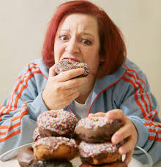
_____________ (is/is not) beneficial because ____________.

Slide 17
_____________ (is/is not) beneficial because ____________.

Slide 18
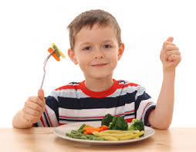
_____________ (is/is not) beneficial because ____________.

Slide 19
1. The students were the main beneficiaries of the new computers at the school. 2. He was the beneficiary of his father’s will.
Do you recognize the root? (whiteboard)
Try out the meaning of the root in the sentence.
What do you think the word means?

Slide 20
Add it to your personal dictionary
word | prefix | suffix | root | definition | sample
Someone
who receives
good
beneficiary
ary
bene
Notes:
Students make an inference about the definition. Teacher/aide monitor and correct as needed. Have the students come up with the answers before answers appear.

Slide 21
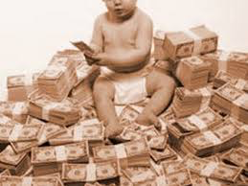
Who is the beneficiary?
She/He is the beneficiary of _______________.

Slide 22
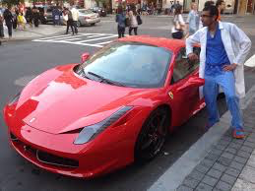
Who is the beneficiary?
She/He is the beneficiary of _______________.

Slide 23
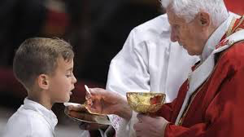
Who is the beneficiary?
She/He is the beneficiary of _______________.

Slide 24
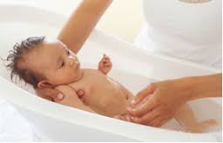
Who is the beneficiary?
She/He is the beneficiary of _______________.

Slide 25
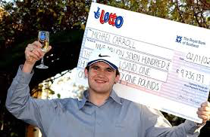
Who is the beneficiary?
She/He is the beneficiary of _______________.

Slide 26
A benevolent uncle paid for her to have music lessons.
Do you recognize the root? (whiteboard)
Try out the meaning of the root in the sentence.
What do you think the word means?

Slide 27
Add it to your personal dictionary
word | prefix | suffix | root | definition | sample
Someone
who makes or
gives good
benevolent
ent
bene
Notes:
Students make an inference about the definition. Teacher/aide monitor and correct as needed. Have the students come up with the answers before answers appear. Note: You want them to try and create a fairly literal definition with root word and prefix.

Slide 28
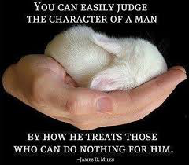
Benevolent, superior, or secretive?
He/She is ___________because______________.

Slide 29
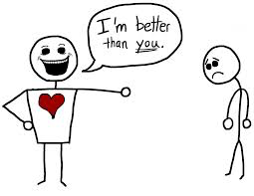
Benevolent, superior, or secretive?
He/She is ___________because______________.

Slide 30
Benevolent, superior, or secretive?
He/She is ___________because______________.

Slide 31
Benevolent, superior, or secretive?
He/She is ___________because______________.

Slide 32
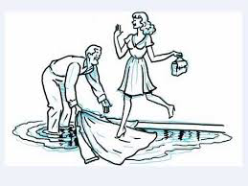
Benevolent, superior, or secretive?
He/She is ___________because______________.

Slide 33
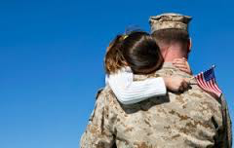
Benevolent, superior, or secretive?
He/She is ___________because______________.

Slide 34
1. An anonymous benefactor donated $2 million. 2. The prosperous benefactor gave the the museum a lot of money.
Do you recognize the root? (whiteboard)
Try out the meaning of the root in the sentence.
What do you think the word means?

Slide 35
Add it to your personal dictionary
word | prefix | suffix | root | definition | sample
One who
makes good
benefactor
or
bene
Notes:
Students make an inference about the definition. Teacher/aide monitor and correct as needed. Have the students come up with the answers before answers appear. Note: You want them to try and create a fairly literal definition with root word and prefix. Before they come up with a definition point out root word fact as factory and see if they can infer it means make.

Slide 36
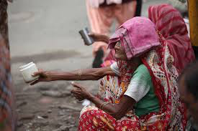
Who do you think is a benefactor?
I think she/he is a benefactor because _________.

Slide 37
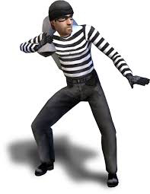
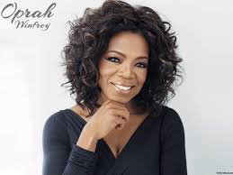
Who do you think is a benefactor?
I think she/he is a benefactor because _________.

Slide 38
1. The old man’s smile was benign.
2. I was worried because I didn’t know if the tumor was benign or malignant.
Do you recognize the root? (whiteboard)
Try out the meaning of the root in the sentence.
What do you think the word means?

Slide 39
Add it to your personal dictionary
word | prefix | suffix | root | definition | sample
Not bad, but not quite good;
harmless
benign
ben
Notes:
Students make an inference about the definition. Teacher/aide monitor and correct as needed. Have the students come up with the answers before answers appear. Note: You want them to try and create a fairly literal definition with root word and prefix.

Slide 40
Benign or malignant?
The difference between the benign mole
and malignant mole is that _______________.

Slide 41
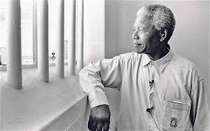
Benign or malignant?
The difference between the benign look and
the malignant look is ___________.

